Slide 1
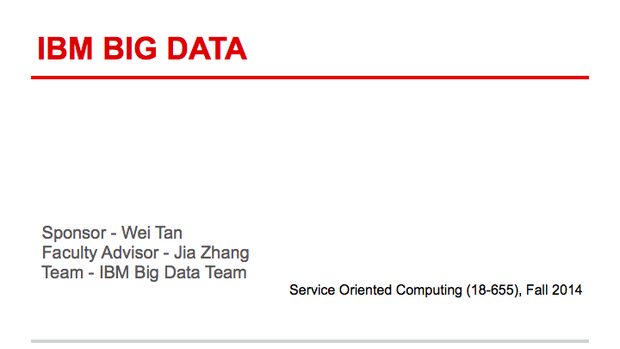

Slide 2
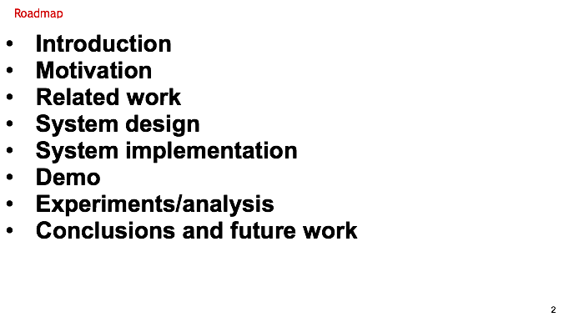

Slide 3

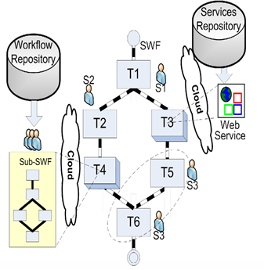
A scientific workflow may leverage published Web services as tasks to speed up workflow composition. To facilitate domain scientists in finding available workflows, several domain-specific online repositories have evolved in recent years.
We aim to analyze and visualize the relationship of workflow and web-service and then build a recommendation engine for scientists who want to build a new workflow.

Slide 4
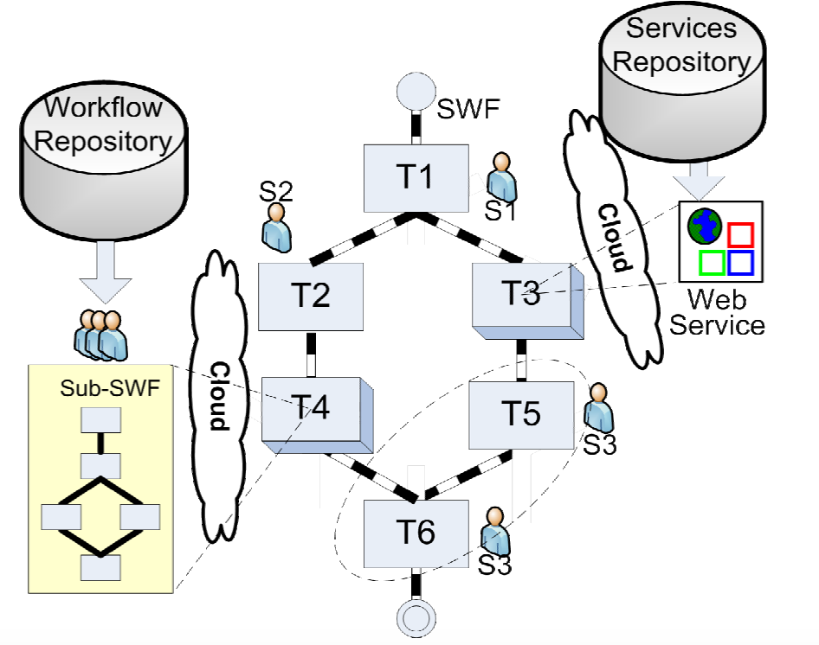
Project Motivation
To accelerate data-intensive scientific exploration, many disciplines including biology and astronomy have adopted workflows as data-pipeline orchestrators to design scientific applications.
As illustrated in this figure, a scientific workflow precisely describes a multistep procedure to streamline a composition of tasks and the dataflow among them.

Slide 5
Project Motivation
Recently emerged services computing technology enables and encourages scientists to expose data and computational resources wrapped as Web services , so that they become publicly available to other researchers through standard interfaces. For example, BioCatalogue has registered over 2,500 life science services.

Slide 6
Project Motivation
A scientific workflow thus may leverage published Web services as tasks to speed up workflow composition. To facilitate domain scientists in finding available workflows, several domain-specific online repositories have evolved in recent years. For example, myExperiment stores over 3,440 life science workflows.

Slide 7

Project Motivation
What implicit knowledge (usage patterns) may be automatically extracted from historical data to help scientists better understand existing artifacts?
How to leverage such data to facilitate scientific artifact reuse?

Slide 8
Related Work
Artifact reuse and recommendation
VisComplete provides auto-complete suggestions for VisTrails system by mining frequent patterns in existing pipelines
Leake et al. propose a case-based approach to suggest the possible next step(s) aiding re-use of portions of prior workflows
Xiao et al. propose a layered workflow structure that allows users to specify workflows at different levels of abstraction, and a graph matching method to find similar ones

Slide 9
Related Work
Visualize data as social network data formats
Harrer et al. transform structured data into social network data formats to visualize dynamic communities
Duong et al. study automatic generation and visualization of personal ontology from personal and organizational websites, blogs, and publications
Viégas et al. propose history flow visualization, as an exploratory data analysis tool, to analyze cooperation and conflict of authorships in the wiki context
Vizster system offers an online visualization of social networking, allowing users to discover communities, people and connections

Slide 10
Related Work
Professor Jia and her team proposed the “Recommend-As-You-Go” approach to support service-oriented scientific workflow reuse in 2011.
Analyze service usage history
Build a PSW network: people, service, workflow
past usage relationships

Slide 11
System Design

Slide 12
Data Collection & Analysis
Parse XML file using Biocatalogue and MyExperiment API and get needed data in java.
Analyze the data and get the relationship between workflows and web services. We also get the relationship between different workflows based on the services they called.

Slide 13


DataSet
Workflow Type | public | private
count | 2510 | 935
percentage | 72.9% | 27.1%
Workflows: 3445
Web Service Type | SOAP | REST
count | 2314 | 212
percentage | 91.6% | 8.4%
Services: 2525

Slide 14
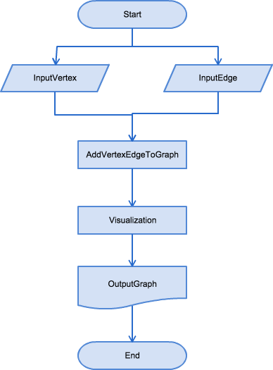

Visualization
Graph: G(V, E) → G(MyNode, MyEdge)
MyNode: Workflow
SOAP Service
REST Service
MyEdge: Directed edge

Slide 15
System Implementation

Slide 16
Data Collection & Analysis

Slide 17
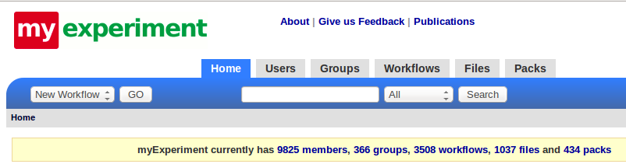
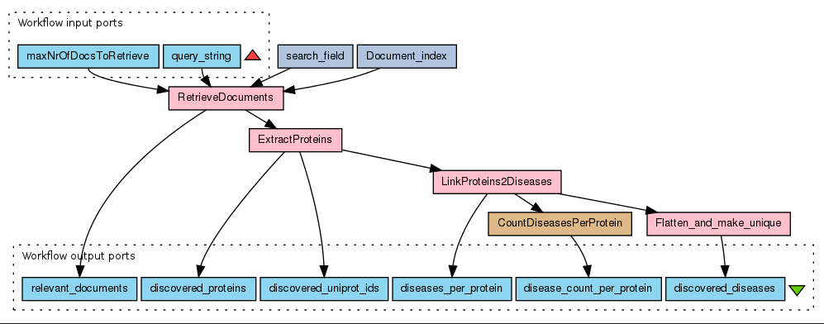
Workflows Raw DataSet
my experiment

Slide 18
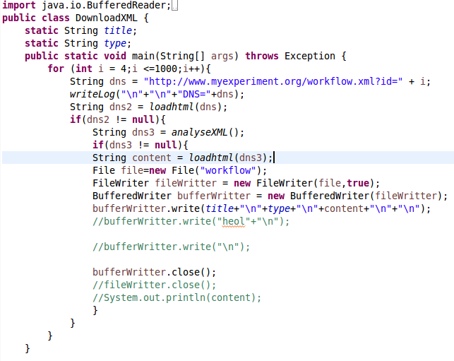
Download Workflows

Slide 19
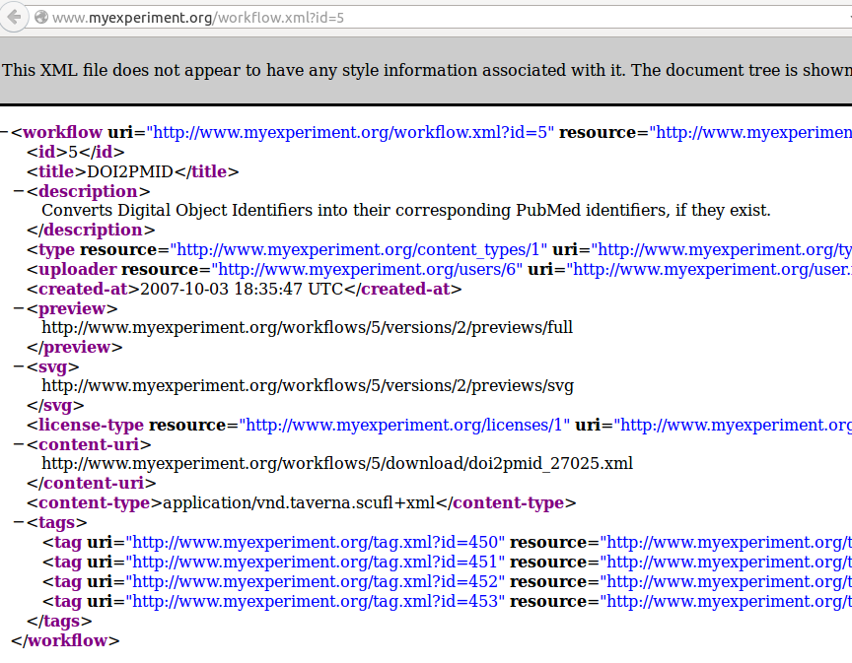
Download Workflows

Slide 20
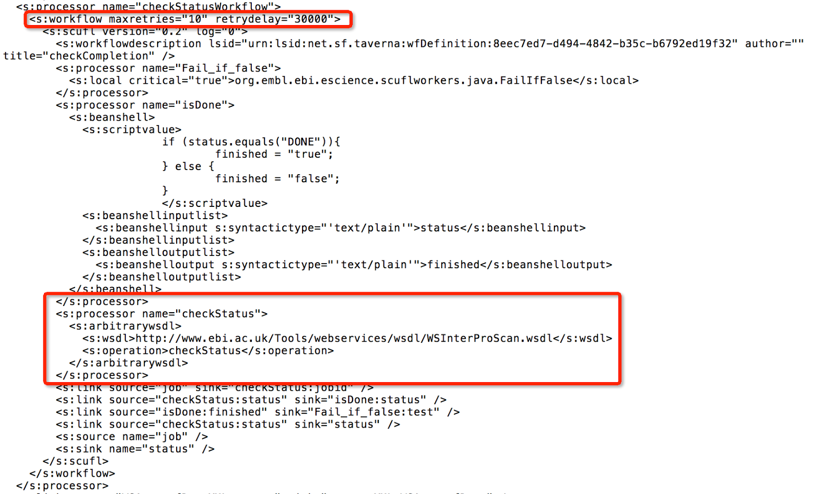
Parsing the xml

Slide 21
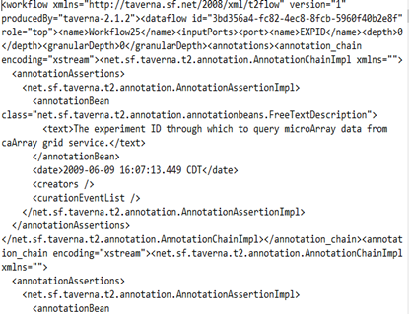
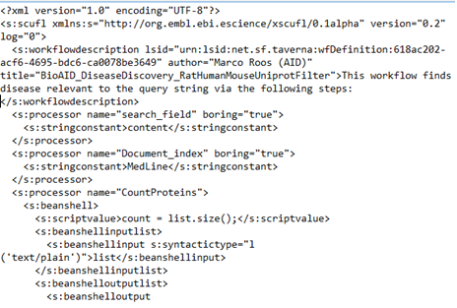
Different types of workflows are encoded in different xml formats.
Parsing the xml
Taverna
Taverna2

Slide 22
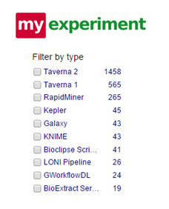
Parsing the xml
We mainly parse and discuss the Taverna 2 and Taverna 1, and we also get some other formats like kepler and Galaxy,and despite some not well-formatted xml and some error code, we totally get 2044 results.

Slide 23
Data Collection & Analysis

Slide 24
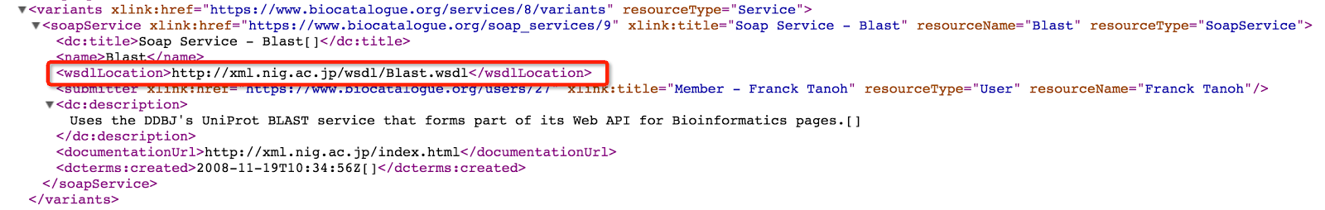
Biocatalogue
SOAP: parse the wsdlLocation
…....
…....

Slide 25
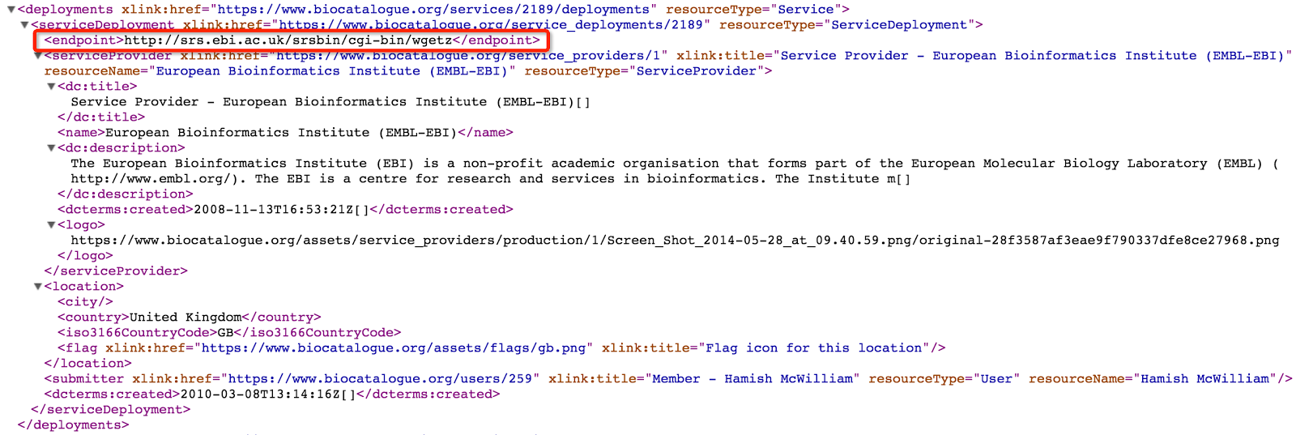
Biocatalogue
REST: parse the API endpoint
…....

Slide 26
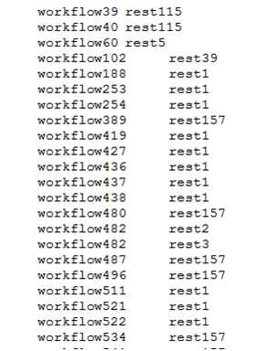
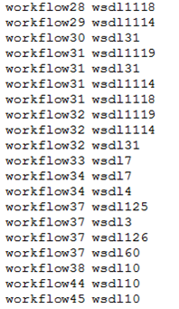
Build the relationship between workflow and web-service
Divide the web-service into two categories:
wsdl & rest
…....

Slide 27
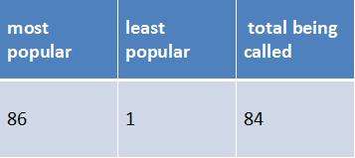
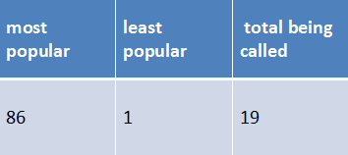
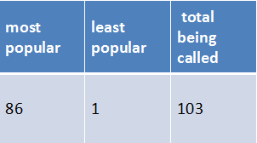
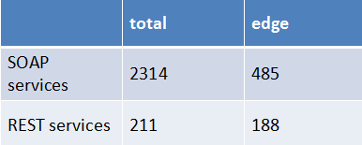
Calculate the "popularity" of each web-service
SOAP
REST
To make the visualization more detailed(the more popular the webservice is, the bigger the size it domains )
Edges
Total
…....

Slide 28
Something about popularity
Rest and soap:
In many data sets,restful apis are dominant. While in scientific domain, soap services are still popular.
Reason:
Scientific services are typically not easy to use – for example, they carry a lot of parameters that need to be understood and properly tuned. Since RESTful APIs lack a way to specify the semantic meanings of such information due to its simplicity, SOAP services can carry significant information in WSDL files.
This is maybe one reason why SOAP services and REST services are still co-exist.
…....

Slide 29
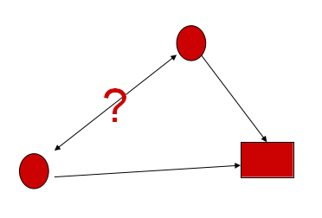
Find the relationship between different workflows
Workflows calling the same webservice may have some similarities
…....

Slide 30
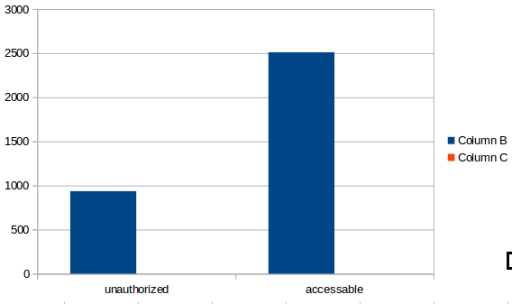
Workflow conditions
condition | COUNT | PROPORTION
unauthorized | 935 | 0.27
accessable | 2510 | 0.73
IN TOTAL : 3445

Slide 31
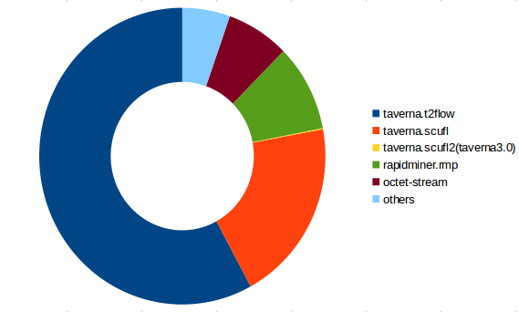
Workflow types
TYPE | COUNT | PROPORTION
taverna.t2flow | 1410 | 0.58
taverna.scufl | 501 | 0.20
taverna.scufl2(taverna3.0) | 3 | 0.0012
rapidminer.rmp | 232 | 0.095
octet-stream | 174 | 0.071
others | 190 | 0.076
IN TOTAL : 2510

Slide 32
DataSet
Workflow Type | public | private
count | 2510 | 935
percentage | 72.9% | 27.1%
Workflows: 3445
Web Service Type | SOAP | REST
count | 2314 | 212
percentage | 91.6% | 8.4%
Services: 2525

Slide 33
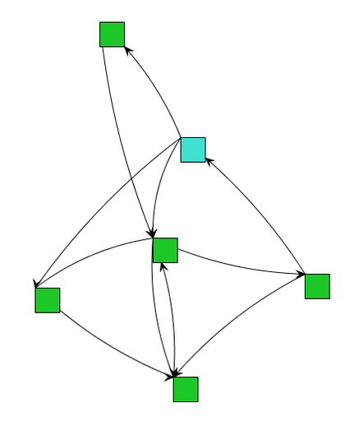
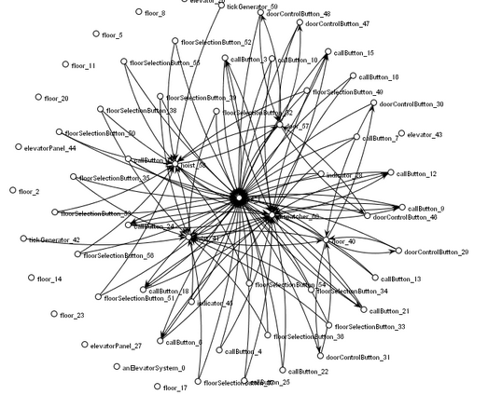
System Implementation
Data Visualization: JUNG

Slide 34
System Implementation
JUNG(Java Universal Network/Graph Framework) to visualize the data and results
Analyze workflows from MyExperiment and web services from BioCatalogue
Represent workflows and services as vertices and their relationship as edges.

Slide 35
System Implementation
The schema of our node class:
id: String
title: String
popularity: int
Differentiate different kinds of
nodes(workflows, RESTful
services and SOAP services) via node id

Slide 36
System Implementation
The schema of our edge class:
id: String
title: String
width: int
Directed edge: from workflow to web service
Undirected edge: from workflow to workflow

Slide 37
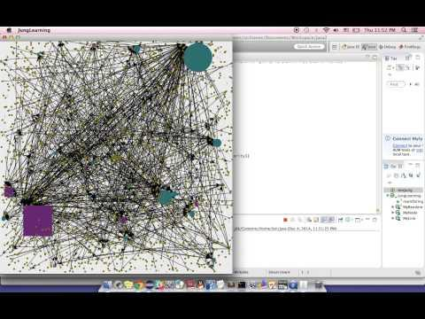
Demo

Slide 38
Experiments/analysis

Slide 39
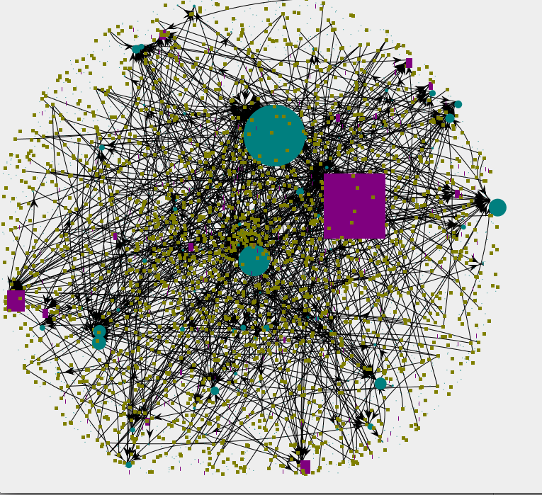
Workflow to Web Service
All workflow and web service nodes:
evolving

Slide 40
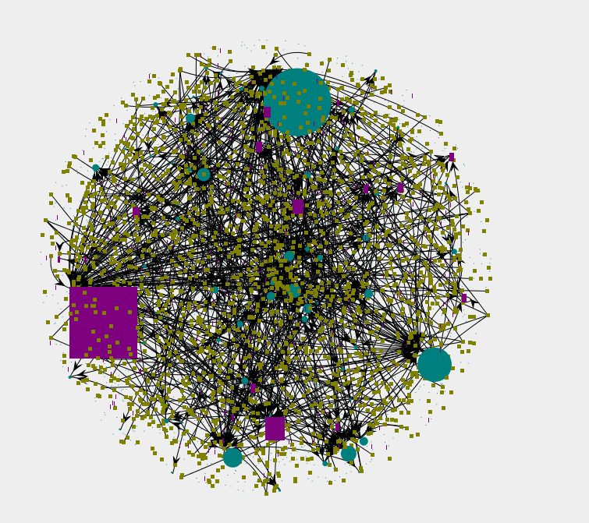
Workflow to Web Service
All workflow and web service nodes:
stable
Whole picture

Slide 41
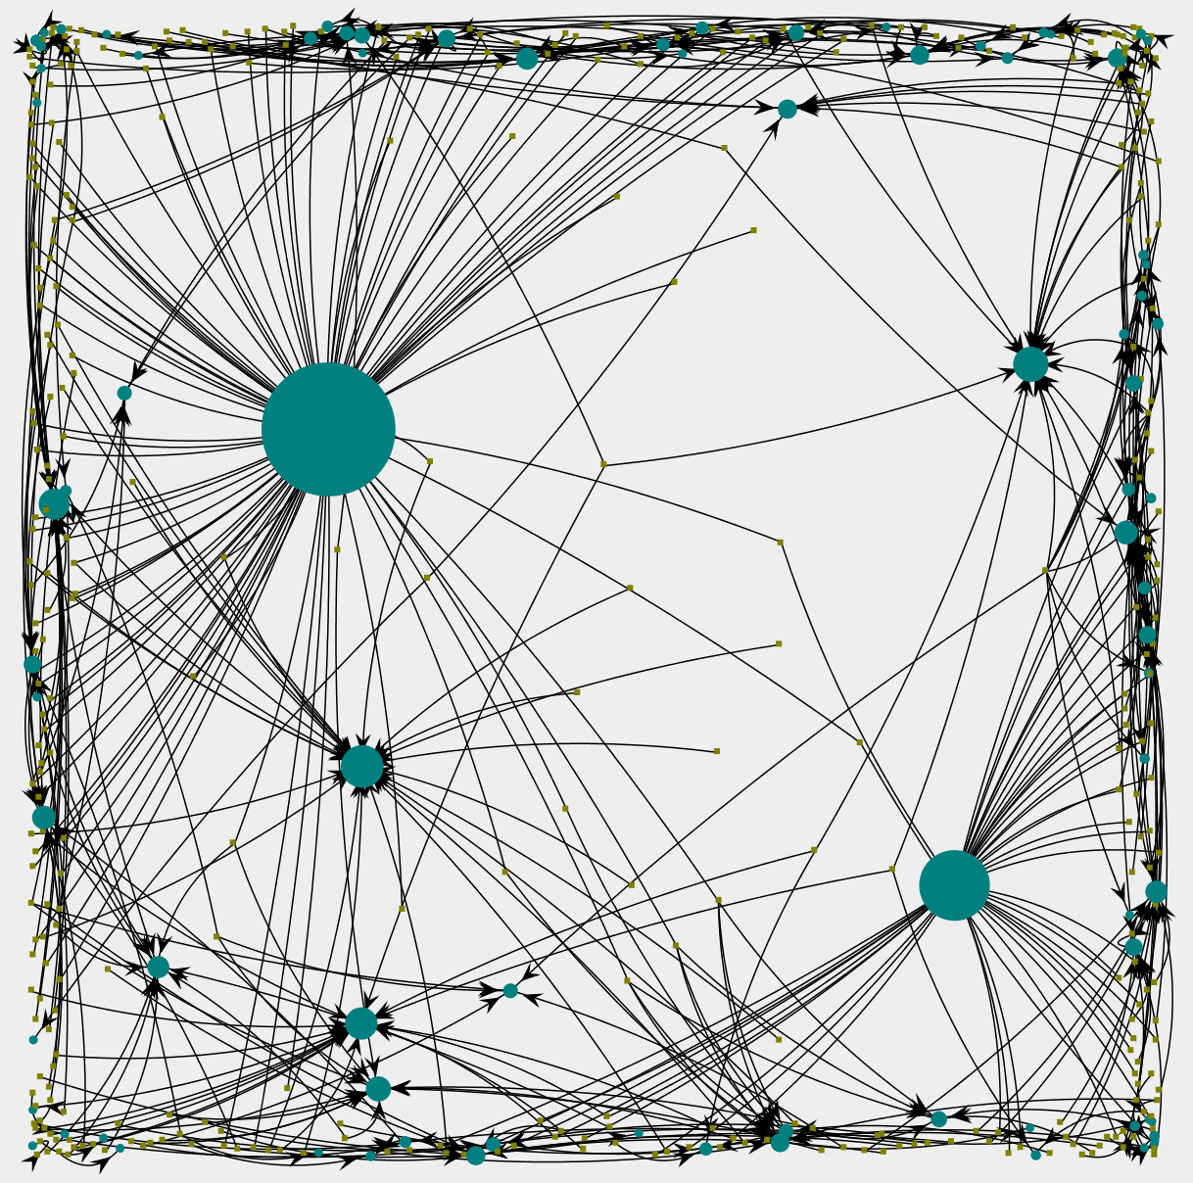
Workflows to SOAP services.
SpringLayout :
A simple force-directed spring-embedder
Highlight popular nodes

Slide 42
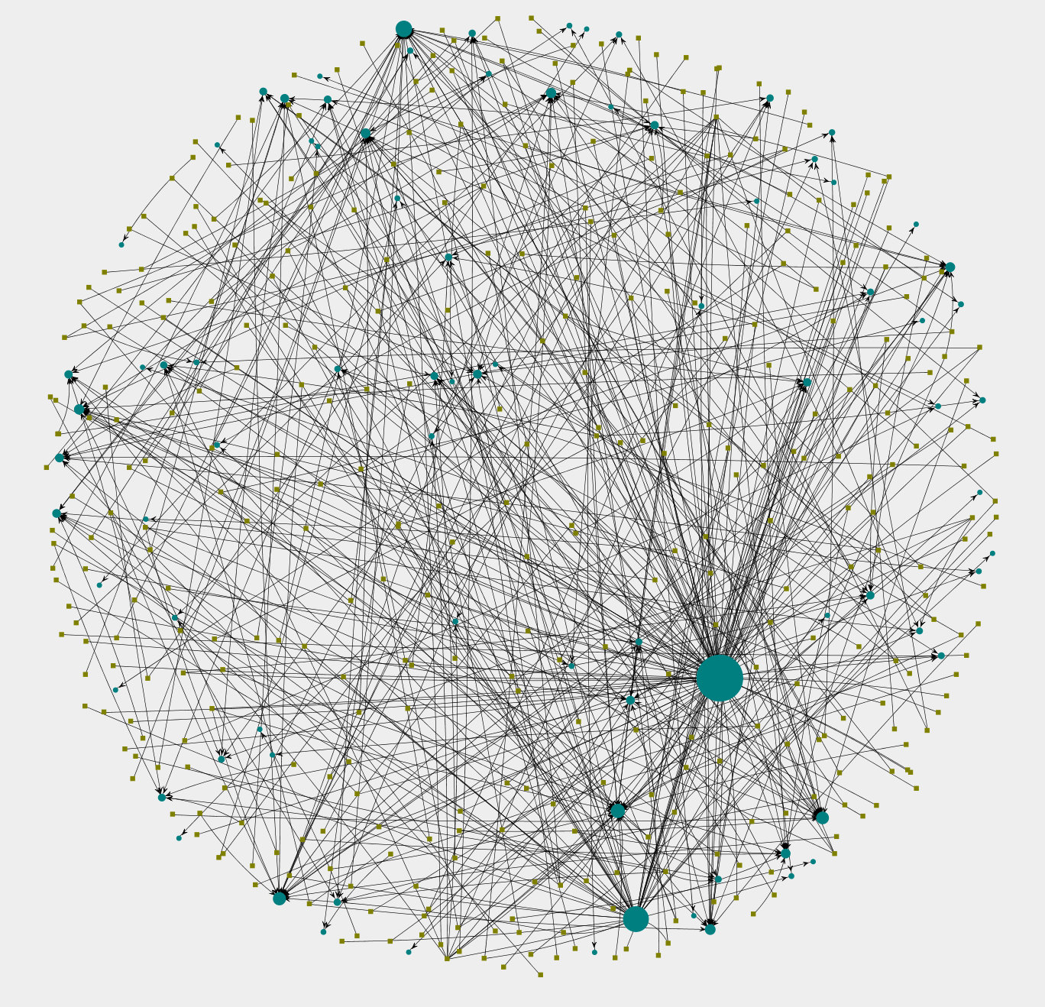
Workflows to SOAP services.
KKLayout:
The Kamada-Kawai algorithm
Condition of all nodes

Slide 43
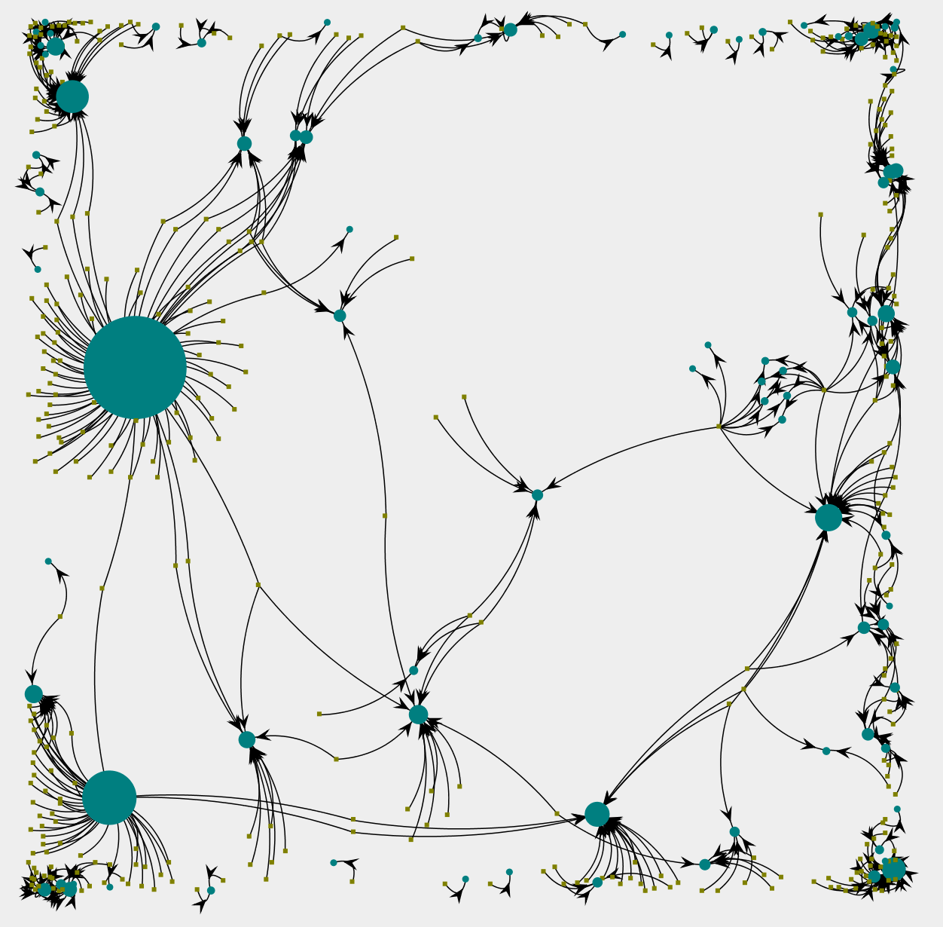
Workflows to SOAP services.
FRLayout :
The Fruchterman-Reingold algorithm
Highlight popular nodes and the structure: can link workflows based on web services

Slide 44
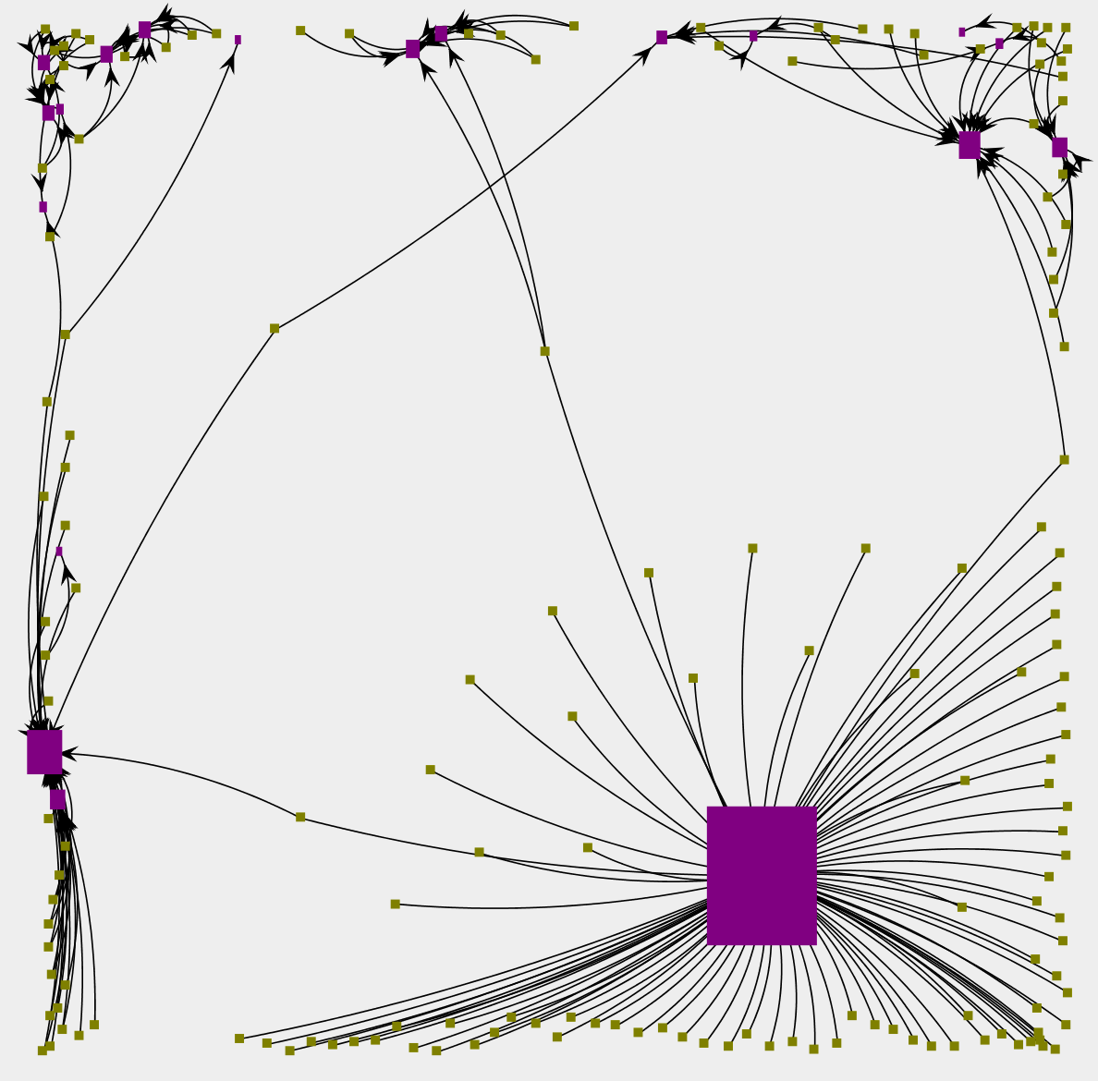
Workflows and REST services.
FRLayout
Highlight popular nodes and the structure: can link workflows based on web services

Slide 45
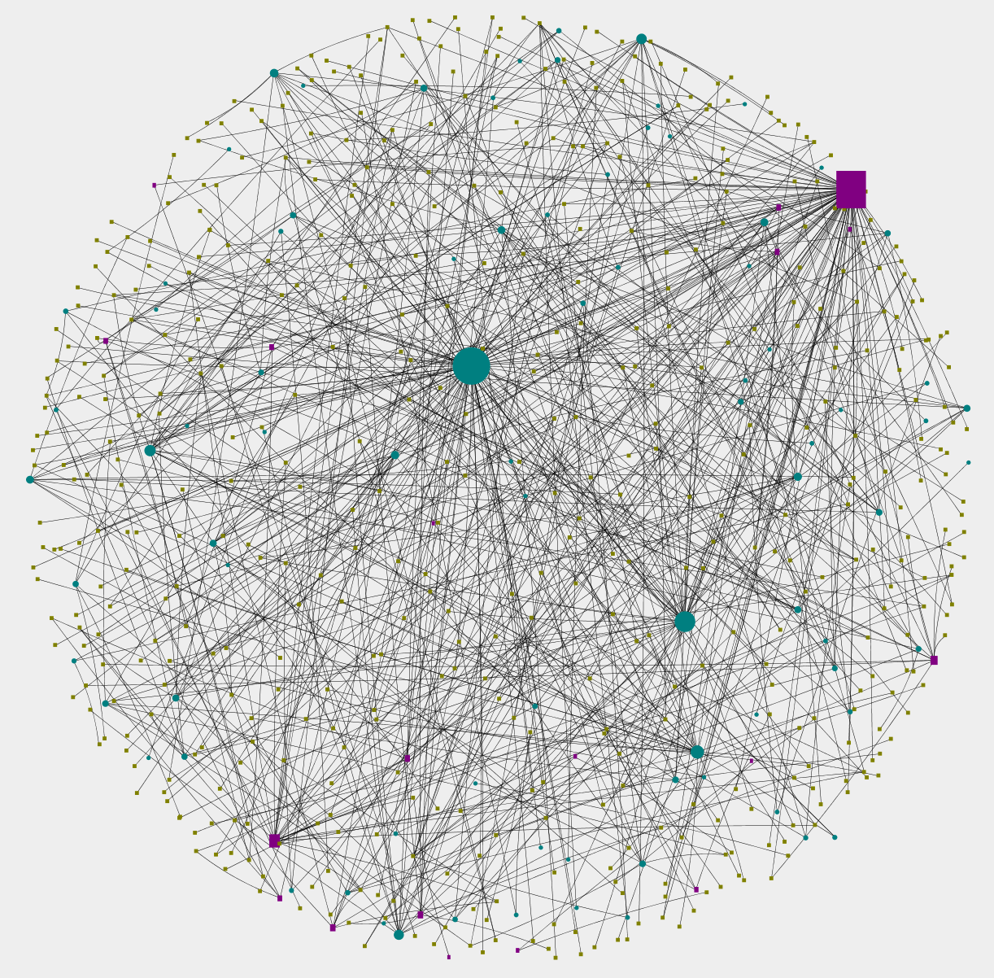
Workflows and all types of web services in KKLayout.

Slide 46
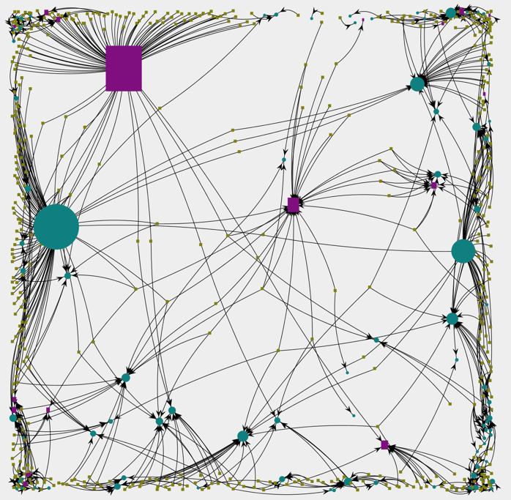
Workflows and all types of web services in FRLayout.
You can see some workflows call both SOAP and REST services.

Slide 47
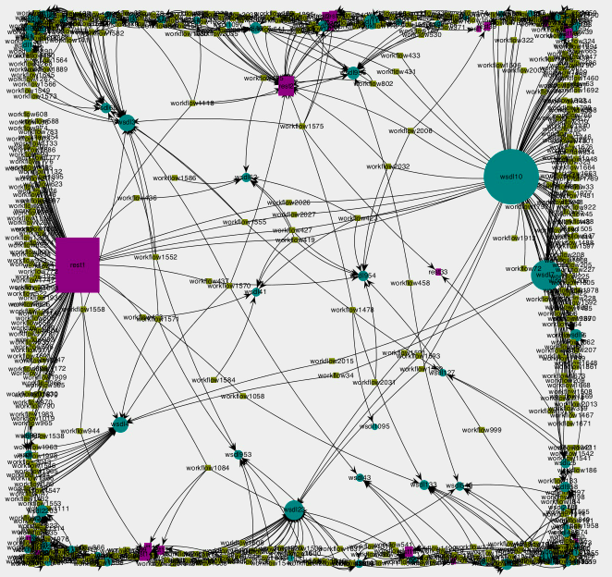
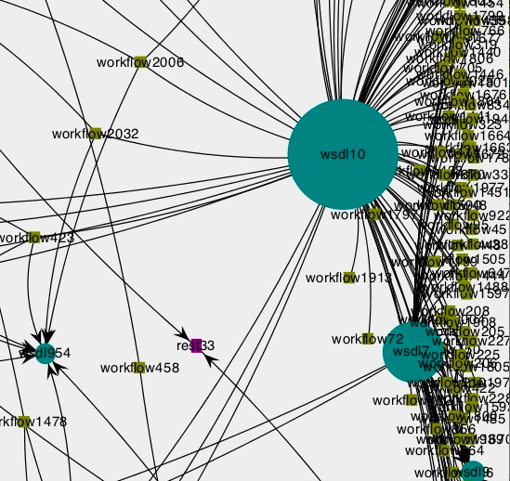
zoom in and out

Slide 48
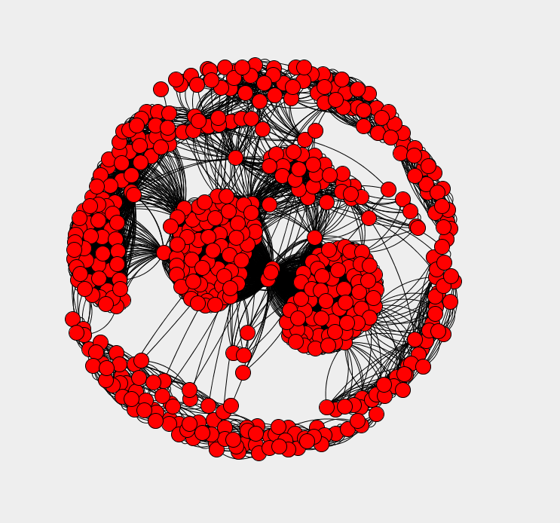
Workflows to Workflows
Based on web services they call

Slide 49
Conclusion
In this project we mainly focus on building a PSW network that can be used to find appropriate artifacts (workflows and services) and obtain advice on their use. During the exploration we find out that much knowledge can be extracted from existing artifacts. By mining historical artifact usage patterns, we show how to answer various queries.

Slide 50
Future work
For further exploration we plan to move on to built a recommendation engine based on our history-based Network analysis techniques and semantics-based discovery ones. We also plan to accumulate practice data to create benchmarks for the presented approach.

